Slide 1


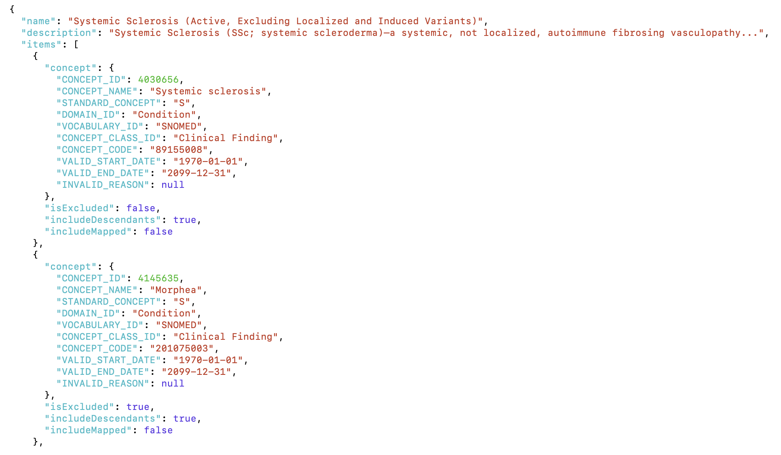


Beyond concept retrieval: reasoning on OMOP vocabulary concepts
Concept set creation remains an intricate topic which requires not only factual knowledge about OMOP vocabularies but sophisticated clinical reasoning
The reality: OMOP concept sets remain complex
The vision: democratising access through natural language
Supported by ATLAS we navigate the complex relationships of clinical concepts
Imagine the access to concept sets being as easy as defining the problem
Create me a concept set for…
Contact: niko.moeller-grell@kcl.ac.uk - linkedin.com/in/niko-moeller-grell

Slide 2







A collaborative effort: breaking down complexity
Deploying a collaborative agentic workflow to address complex clinical queries, breaking them down into achievable tasks.
The collaboration: Task decomposition
The heavy lifting: knowledge graph traversal and vector search
Specialised agents designed to handle different subtasks of OMOP CDM analysis
Decomposition of complex clinical reasoning into archivable subtasks
Reliable, deterministic and explainable tool calling
Storage of the depth of information contained in OMOP vocabularies
Orchestrator
OMOP vocabulary embeddings
OMOP vocabulary relationships
Clinical NER agent
Semantic retriever
Concept reasoner
Concept-set creator
Concept-set validator
Clinical Definition
Agentic workflow
Knowledge graph traversal
Result synthesising
Contact: niko.moeller-grell@kcl.ac.uk - linkedin.com/in/niko-moeller-grell

Slide 3


Towards concept reasoning: why relationships matter
Designing meaningful databases for semantic information retrieval
Enhancing explainabilty: the agentic workflow
Myocardial Infarction
4329847
Heart Attack
4329847
MI - myocardial infarction
4329847
Cardiac infarction
4329847
Myocardial infarct
4329847
Has finding site
Is a
Associated finding of
FH myocardial infarction female
first degree age known
4152388
Myocardium structure
4253786
Ischemic heart disease
4185932
Contact: niko.moeller-grell@kcl.ac.uk - linkedin.com/in/niko-moeller-grell

Slide 4
Thinking coarse and thinking fine: rigorous semantics with flexible reasoning
Building a trustworthy workflow: from flexible reasoning to guarded execution.
Disambiguate concepts through heuristics on hierarchy
Create me a concept set for…SLE without drug induced SLE
Systemic Lupus Erythematosus
257628
Drug-induced lupus erythematosus
4198217
Is a
Is a
Lupus erythematosus
255891
Systemic lupus
erythematosus
255891
Contact: niko.moeller-grell@kcl.ac.uk - linkedin.com/in/niko-moeller-grell

Slide 5
Navigating pitfalls: layered reasoning
Building a trustworthy workflow: from flexible reasoning to guarded execution.
Enhancing explainabilty: the agentic workflow
Semantic matching for flexible yet reliable retrieval
Building the right heuristics for the model to traverse knowledge graphs builds the foundation of concept reasoning
Hierarchical relationships for granularity and concept disambiguation
Clinical relationships for causal reasoning and clinical sanity checks
Contact: niko.moeller-grell@kcl.ac.uk - linkedin.com/in/niko-moeller-grell

